Slide 1
Promotion Criteria 3rd, 5th, and 8th Grades
BIBB COUNTY SCHOOL DISTRICT
Leadership. Scholarship. Citizenship.

Slide 2
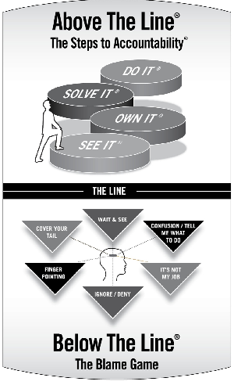
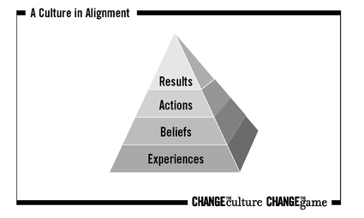
Who We Are
OUR VISION
Each student demonstrates strength of character
and is college or career ready.
OUR MISSION
The Bibb County School District will develop a highly trained
staff and an engaged community dedicated to educating
each student for a 21st century global society.
OUR VALUES
COMPETENCY LOYALTY OPEN COMMUNICATION DEFINED AUTONOMY HONOR
OUR NON-NEGOTIABLES
PBIS
RTI
FIP
TKES & LKES

Slide 3
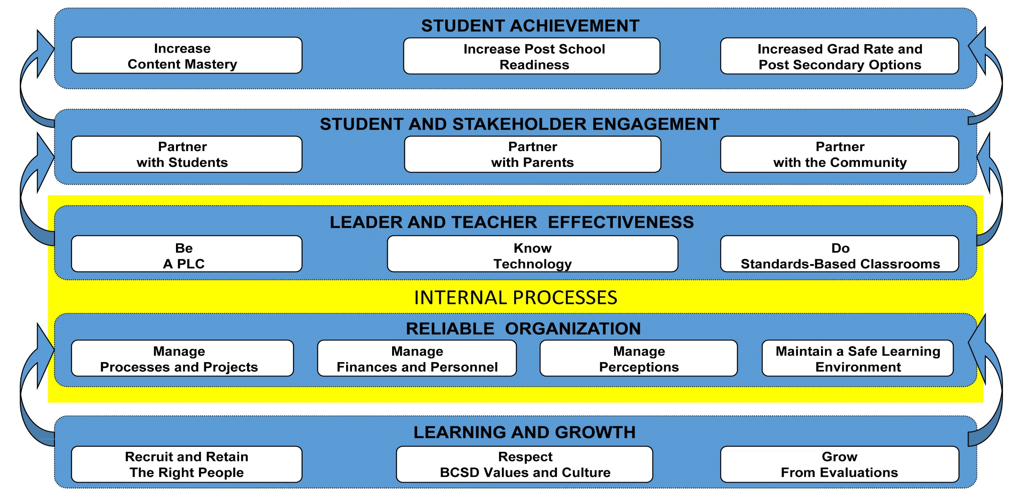
Victory in Our Schools
Overriding Objective = CCRPI > 70
STRATEGIC PRIORITIES
Priority 1: Get students reading on grade level.
Priority 2: Be successful on the Georgia Milestones.
Priority 3: Increase the number of students in school every day.
Priority 4: Close the knowing-doing gap.
Priority 5: Work hard to support schools.
Priority 6: Establish a culture of accountability for everyone.

Slide 4
Promotion, Placement and Retention Law
In July 2003 the state passed the Georgia Promotion, Placement, and Retention Law which requires 3rd, 5th and 8th grade students to pass parts of the state assessment (Georgia Milestones).
In addition to successfully meeting promotion requirements, 3rd, 5th and 8th grade students must pass the following Milestones Tests:
3rd Grade Reading
5th Grade Reading and Math
8th Grade Reading and Math
The purpose of this meeting is to make sure students and parents are aware of the promotion and administrative placement requirements.

Slide 5
Promotion Criteria for Third Grade
Grade 3: To be promoted to Grade 4, a student must meet the following requirements:
Earn a passing final grade in English/Language Arts (70 and above).
Earn a passing final grade in Mathematics (70 and above)
Earn a passing final grade in Science or Social Studies.
Score “On/Above Grade Level” on the Georgia Milestones End-of-Grade Assessment in Reading.
Meet attendance requirements.

Slide 6
Promotion Criteria for Fifth Grade
Grade 5: To be promoted to Grade 6, a student must meet the following requirements:
Earn a passing final grade in English/Language Arts (70 and above).
Earn a passing final grade in Mathematics (70 and above).
Earn a passing final grade in Science or Social Studies.
Score “On/Above Grade Level” on the Georgia Milestones End-of-Grade Assessment in Reading.
Earn an achievement level of “Developing Learner”, “Proficient Learner”, or “Distinguished Learner” on the Mathematics section of the Georgia Milestones End-of-Grade Assessment.
Meet attendance requirements.

Slide 7
Promotion Criteria for Eighth Grade
Grade 8: To be promoted to Grade 9, a student must meet the following requirements:
Earn a passing final grade in English/Language Arts (70 and above).
Earn a passing final grade in Mathematics (70 and above).
Must pass at least two of the remaining courses.
Earn “On/Above Grade Level” on the Georgia Milestones End-of-Grade Assessment in Reading.
Earn an achievement level of “Developing Learner”, “Proficient Learner”, or “Distinguished Learner” on the Mathematics section of the Georgia Milestones End-of-Grade Assessment.
Meet attendance requirements.

Slide 8
Milestones Administration
Dates: April 8-24, 2019
Attendance: Mandatory for all students in Grades 3-8
Have to take the test to be considered for promotion or administrative placement
Students must score at least “On Grade Level” for Reading (3rd); at least “On Grade Level” for Reading and “Developing Learner” for Math (5th and 8th)
No passing score(s) = retention; therefore, a student must take the Milestones Test
Make-up testing days will be available for illnesses.

Slide 9
Milestones Re-Test
If a student does not pass the required Milestones Tests in Reading and Math, he/she will have an opportunity to take the test again.
To better meet the needs of all students, after testing every school will have a specific plan of intervention strategies for all students during the last 4 weeks of school.
Students in Grades 3, 5, & 8 that need to take the Milestones Re-Test in Reading and/or Math will test in their home schools on May 14-17, 2019.
May 14 | May 15 | May 16 | May 17
ELA – 5th grade | Math – 5th grade | ELA – 3rd grade | Make-Up
ELA – 8th grade | Math - 8th grade | Make-Up | Make-Up

Slide 10
BCSD Administrative Placement Rubric 3rd, 5th, 8th
If a student does not pass the Milestones Re-Test, we will use this rubric to determine if a student can be administratively placed to the next grade level.
3rd Grade | Points | 5th Grade | Points | 8th Grade | Points
STAR Scale Score | Up to 5 points | STAR Scale Score | Up to 5 points | STAR Scale Score | Up to 5 points
STAR Growth | Up to 3 points | STAR Growth | Up to 3 points | STAR Growth | Up to 3 points
Student Grades | Up to 5 points | Student Grades | Up to 5 points | Student Grades | Up to 5 points
Attendance | Up to 3 points | Attendance | Up to 3 points | Attendance | Up to 3 points
Total Points | 16 TOTAL POSSIBLE POINTS | Total Points | 16 TOTAL POSSIBLE POINTS | Total Points | 16 TOTAL POSSIBLE POINTS
STAR Assessment – Standardized, computer-adapted assessments used for screening students in reading and math
STAR Scale Score – Used to compare student performance
STAR Growth – Norm-referenced quantification of individual student growth (0-34 Low; 35- 65 Typical, 66-99 High)

Slide 11
BCSD Administrative Placement Rubric 3rd, 5th, 8th
3rd Grade | Points | 5th Grade | Points | 8th Grade | Points
STAR Benchmark Scale Score | Scored > 40th percentile - 5 pts Scored > 30 pctl but < 40 - 4 pts Scored > 20 pctl but < 30 - 3 pts Scored > 10 pctl but < 20 - 2 pts Scored less than 10 pctl - 1 pts | STAR Benchmark Scale Score | Scored > 40th percentile - 5 pts Scored > 30 pctl but < 40 - 4 pts Scored > 20 pctl but < 30 - 3 pts Scored > 10 pctl but < 20 - 2 pts Scored less than 10 pctl - 1 pts | STAR Benchmark Scale Score | Scored > 40th percentile - 5 pts Scored > 30 pctl but < 40 - 4 pts Scored > 20 pctl but < 30 - 3 pts Scored > 10 pctl but < 20 - 2 pts Scored less than 10 pctl - 1 pts
STAR Growth | High Growth -3pts Typical Growth -2pts Low Growth -1pt | STAR Growth | High Growth -3pts Typical Growth -2pts Low Growth -1pt | STAR Growth | High Growth -3pts Typical Growth -2pts Low Growth -1pt
Student Grades | Grade > 90 - 5 pts Scored > 80 but < 90 - 4 pts Scored > 70 but < 80 - 3 pts Scored > 65 but < 70 - 2 pts Scored > 60 but < 65 - 1 pts | Student Grades | Grade > 90 - 5 pts Scored > 80 but < 90 - 4 pts Scored > 70 but < 80 - 3 pts Scored > 65 but < 70 - 2 pts Scored > 60 but < 65 - 1 pts | Student Grades | Grade > 90 - 5 pts Scored > 80 but < 90 - 4 pts Scored > 70 but < 80 - 3 pts Scored > 65 but < 70 - 2 pts Scored > 60 but < 65 - 1 pts
Attendance | < 5 (excused or unex) -3pts 6 to 10 absences -2pts 11 to 15 absences -1pt | Attendance | < 5 (excused or unex) -3pts 6 to 10 absences -2pts 11 to 15 absences -1pt | Attendance | < 5 (excused or unex) -3pts 6 to 10 absences -2pts 11 to 15 absences -1pt
Total Points | total > 12 Opportunity to be admin placed total < 12 Opportunity to attend summer school | Total Points | total > 12 Opportunity to be admin placed total < 12 Opportunity to attend summer school | Total Points | total > 12 Opportunity to be admin placed total < 12 Opportunity to attend summer school

Slide 12
BCSD Administrative Placement for 3rd, 5th, 8th
Administrative Placement with Enrollment in Targeted Remediation 2019-2020:
Students obtaining a score of 12 out of 16 on the Administrative Placement Rubric will be administratively placed and enrolled in Targeted Remediation.
Parents and students will sign a contract agreeing to complete all requirements for administratively placed students.

Slide 13
BCSD Summer School For 3rd, 5th, 8th
Summer School and Enrollment in Targeted Remediation 2019-2020:
Students receiving below 12 points on the Administrative Placement Rubric will need to attend Summer School. Summer School: Mondays – Thursdays – June 3rd – June 27th
Successful completion of Summer School requirements:
Student must obtain a STAR 360 benchmark score in the 10th percentile or higher (for next grade level).
Student must not have more than 2 absences in Summer School.
Student must not have any discipline issues in Summer School.
Students who successfully complete Summer School will be administratively placed and enrolled in Targeted Remediation UNTIL student reaches the 25th percentile for the current grade level in reading and/or math.
Student must then complete all requirements for administratively placed students.
Students who do not successfully complete Summer School will be retained.

Slide 14
Students will be retained in the current grade level who:
Retention
Failed the Milestones in:
3rd Grade Reading
5th Grade Reading and/or Math
8th Grade Reading and/or Math
Did not qualify for Administrative Placement
Did not SUCESSFULLY complete Summer School
Did not ATTEND Summer School

Slide 15
What Can You Do to Help?
Keep in close contact with your child’s teacher if your child is making low grades in Reading and/or Math.
Monitor your child’s grades.
Spend 20 minutes reading with your child each day and take turns reading.
Ask your child questions about what was read: specific facts, comprehension and predictions.
Review math facts and provide practical examples and problems.
Ensure that homework is done nightly to reinforce concepts being taught in the classroom.
Ask for additional work to help areas of weakness.
Help your child be prepared to learn every day!

